Slide 1








WEEKLY
REPORT
SAMUEL SUKARNO
2 nov 2024

Slide 2
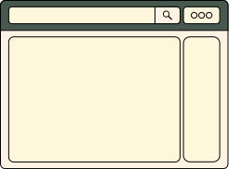

HAsIl mingguan
  Revisi Compro untuk Business Unit Detail Page di dashboard compro
  Revisi Blog, Study di Dashboard Compro
  Integrasi:
    Document
    Employee
    Bisnis Unit Eureka Dashboard
    Cabinet
    Department
    Designation
    Job Level
    Office
    Document Category

Slide 3
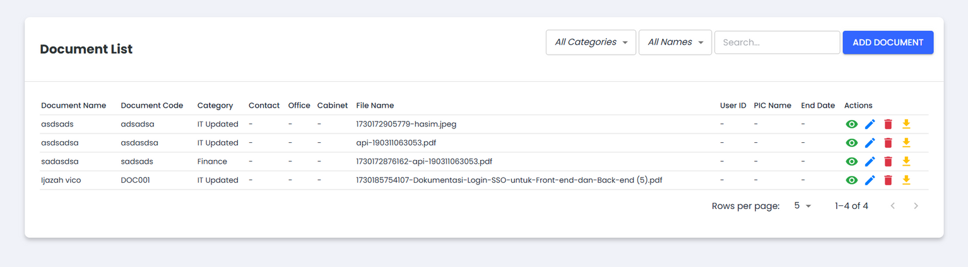
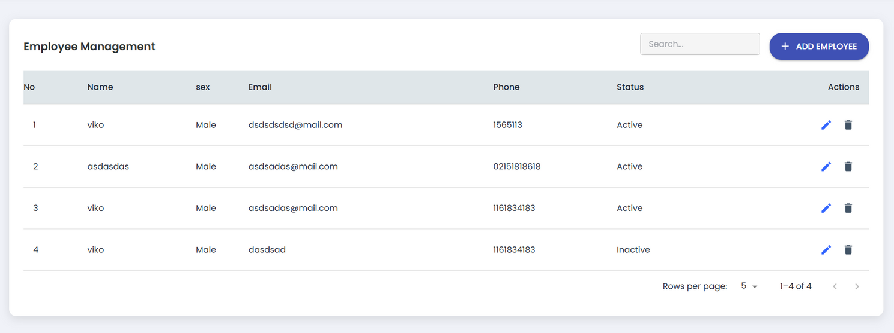

Slide 4
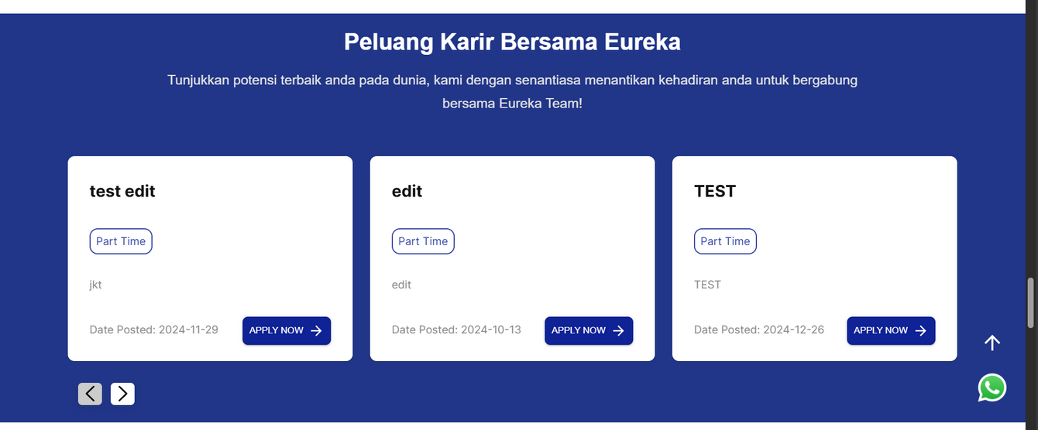
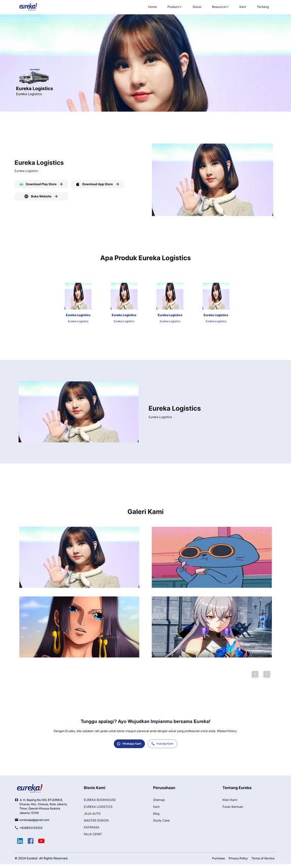
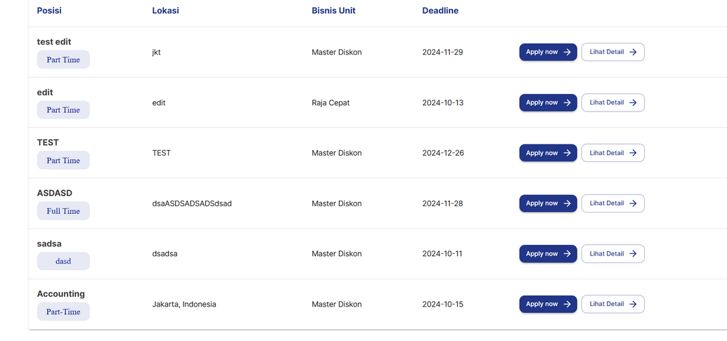
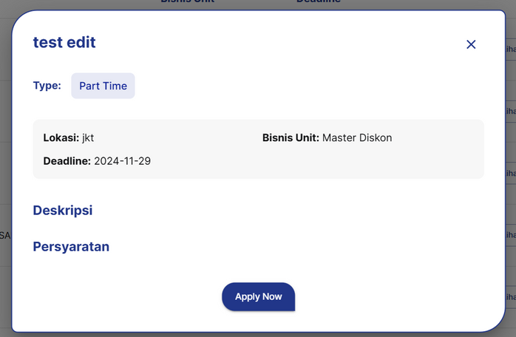

Slide 5
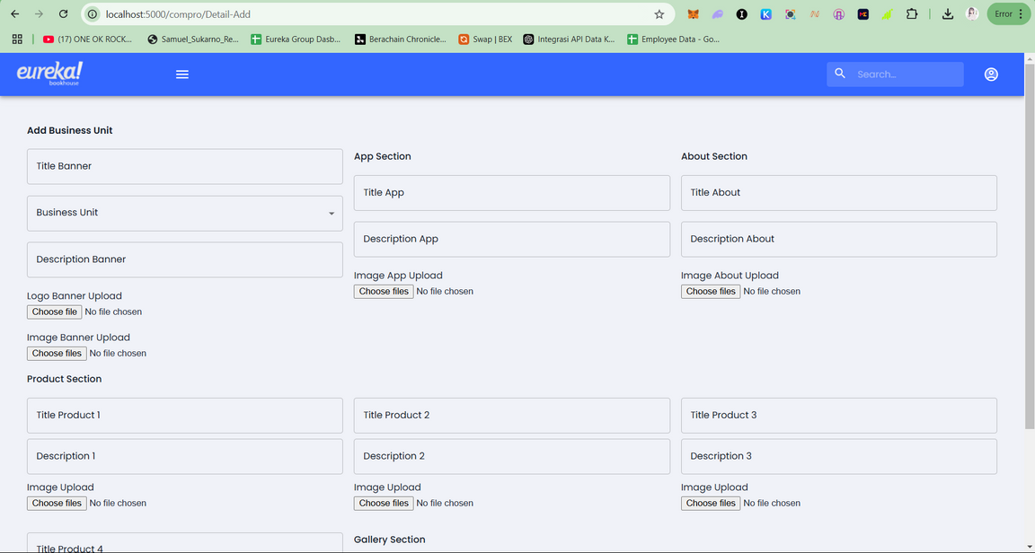
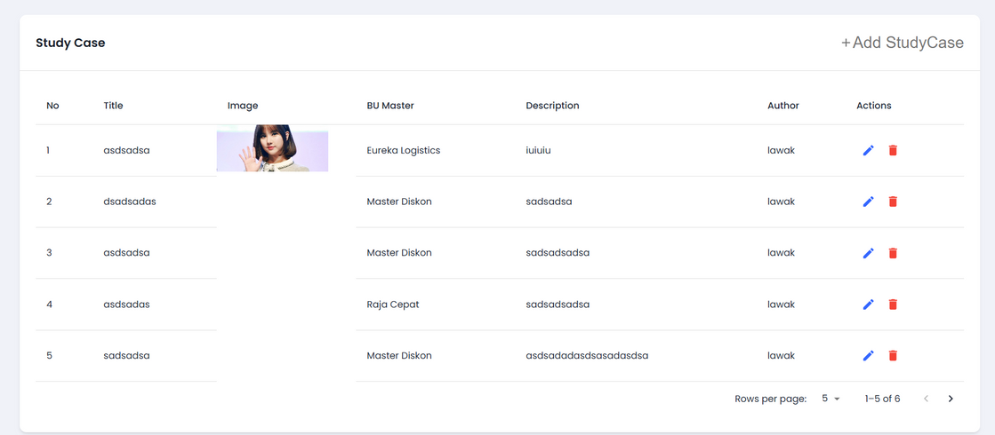
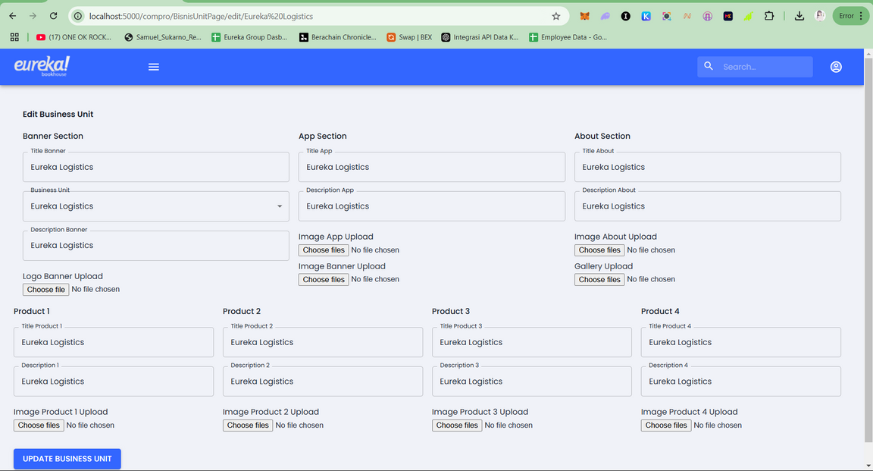
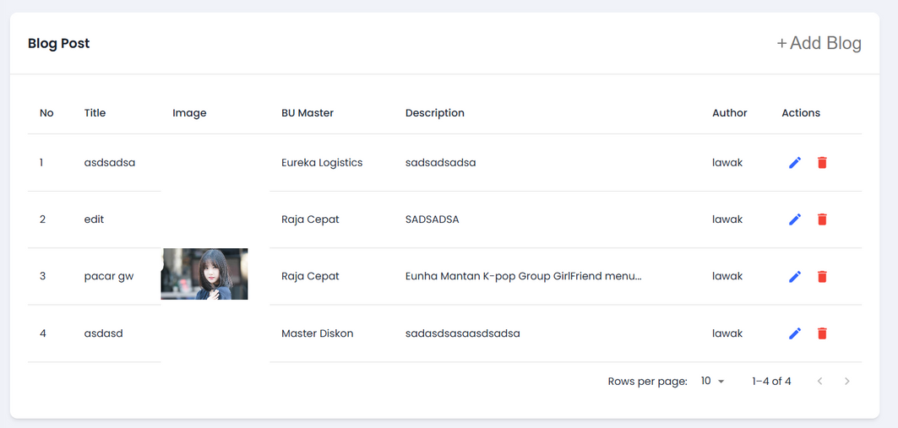

Slide 6
Terima Kasih

